Slide 1
Watch Recomender
DISPRO2 – FS24
Teresa Windlin, Luka Bozovic

Slide 2
Explanations that have worked with people
Visual distance, then moved richtung brand
Can you imaging a person that wears the inputed watch also to recommended watch?
Want a watch which isn’t ‘zum-verwechseln-ähnlich’

Slide 3
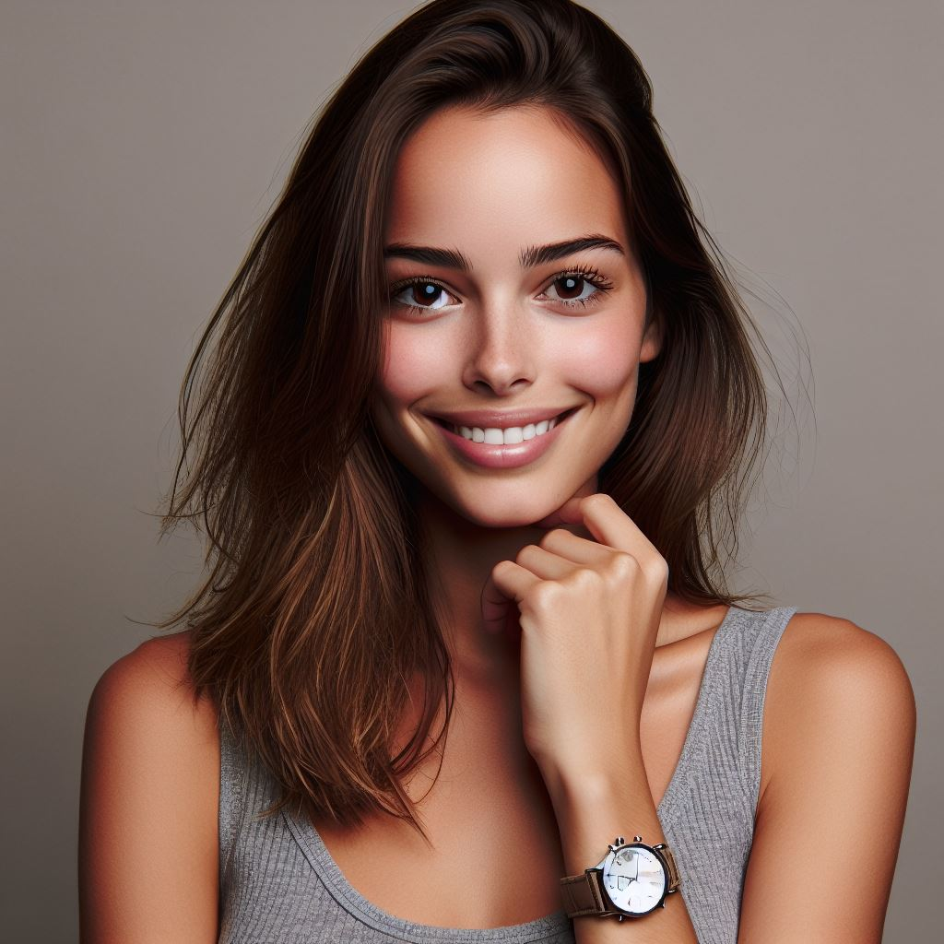
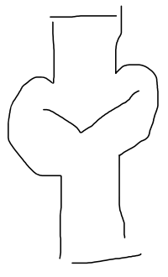



Meet Claire, loves her first watch but struggling to find more she likes
? ? ?
Occupation: Engineer
Income: Average
Location: Lyon, France

Slide 4
How she choses her watch
Wants a durable and exact movement after her research on mechanical watches
Within a dial diameter range that is suitable for her wrist
Not overpriced
With a design she likes
cant pinpoint exactly what makes her like/dislike a watch

Slide 5
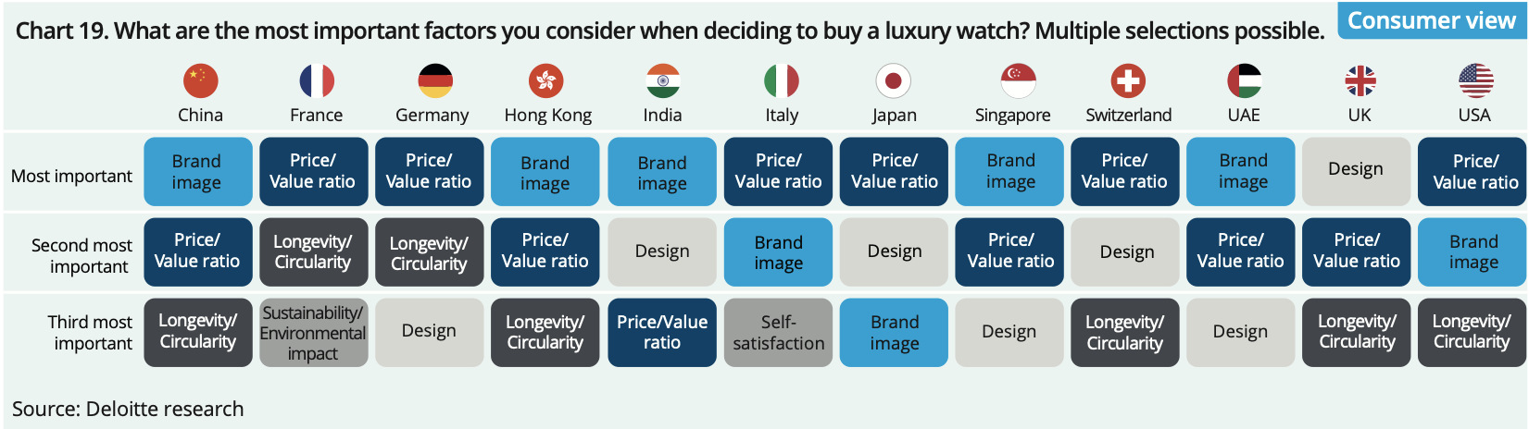
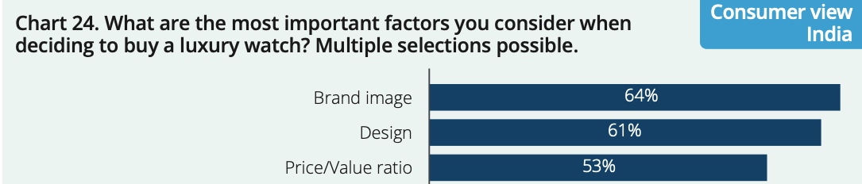
Random stats: Why we focus on what we focus on
Random stats, Deloitte report

Slide 6
Step back in watch industry Buyers & Sellers of Watchpieces
Tayloring towards enthusiasts
As less & less ppl wear watches
Our dataset contains few fashion brands
For ‘timepiece’ makers:
Ratio top companies & percentage of total sales even more extreme
These top companies:
Pay premium for brand (marketing, exclusivity, scarcity, ect)
Microbrands: better value for money, but hard to find as no marketing budegt

Slide 7
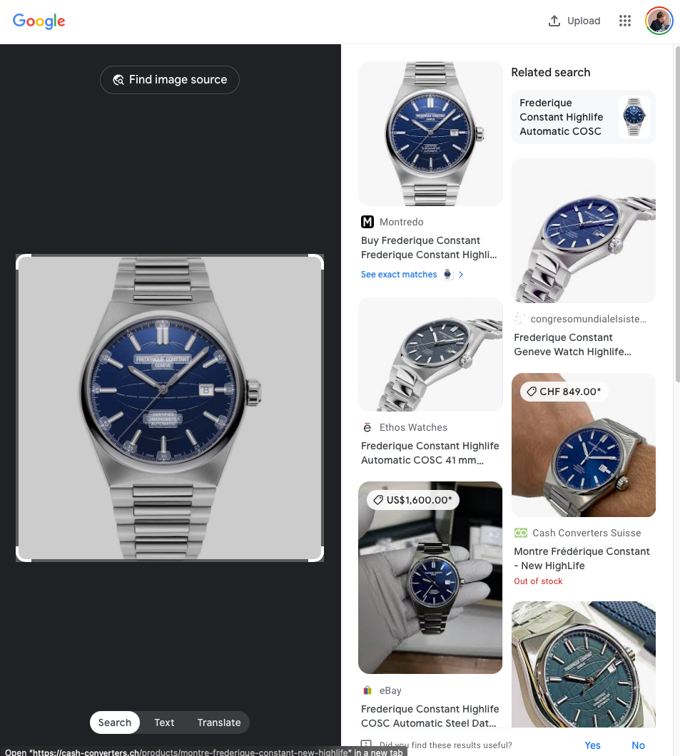
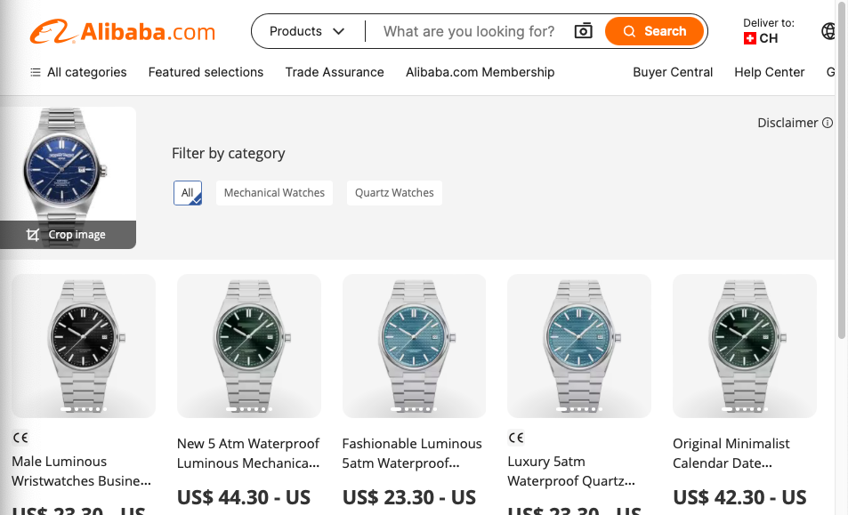
Her approach: inserted her watch into different programs, but only received info on the same watch or replicas.
But Claire wants an additional watch that she loves without investing too much time in search

Slide 8
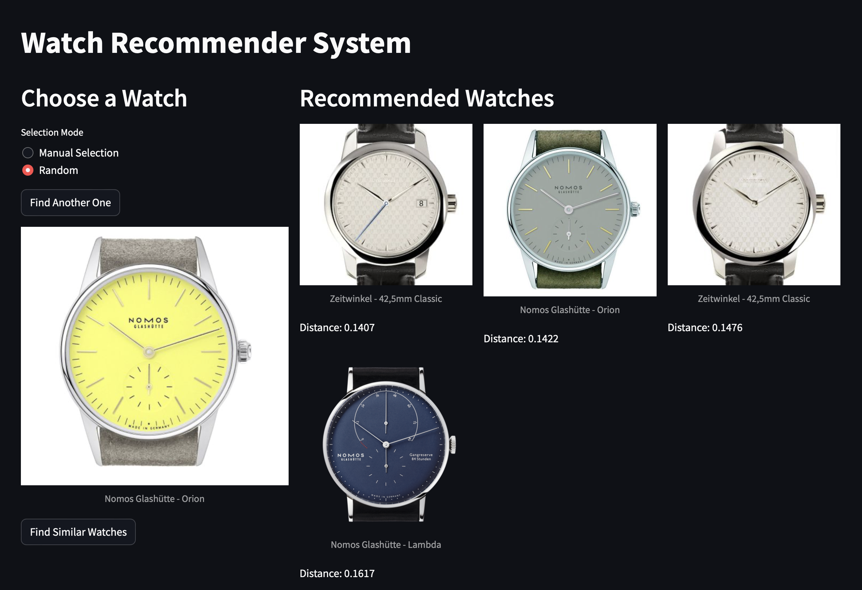
Our Website
Based on a input watch, recommend watch with a similar aesthetic not nessesarily same characteristics

Slide 9
User story
Gets more into watches,
W. engineering background fascinated by the movements,
Size important as must be proportion to wrist,
→ filter on website for diameter of watch (‘case diameter’), could be more complex inf future
Finds out about different glass types (e.g. sapphire)
→ filter on website
Struggles with high prices of wellknown brands and found some unknown brands (microbrands) with an inspired design what user also likes
Finds them on a reddit forum but this search very time intensive.
→ idea behind algorithm: to recommend watch must be in our dataset, but no need to retrain model to recommend watch

Slide 10
Dataset
10’000 watches, 100 brands, 300 models (bring example of model)
What in json.
Distribution of brands & models

Slide 11
Data Split
Split 4 entire brands remove from training for validation set

Slide 12
User taste
Recap what we want: based on a watch a user liked, find another watch a user would also like.
User taste:
User might like a certain aestetic (e.g. minimalist, 60s, retro) but still different types of watches
Instert

Slide 13
Hypothesis style
Recap what we want: based on a watch a user liked, find another watch a user would also like.
User taste:
User might like a certain aestetic (e.g. minimalist, 60s, retro) but still different types of watches
Assumption on underlying design:
One brand has an overall design language (e.g. brand nomos inspired by Bauhaus, LUKA Add example)
Analogy: artist and painting
Bit more complex as different range of eastetic diversity between brands, but as analgoy
This actually Inspiration for project, in US NN trained to predict if user will like painting (only difference this project trained on explicit user feedback, vs we only evaluate on explicit user feedback) ADD SOURCE

Slide 14
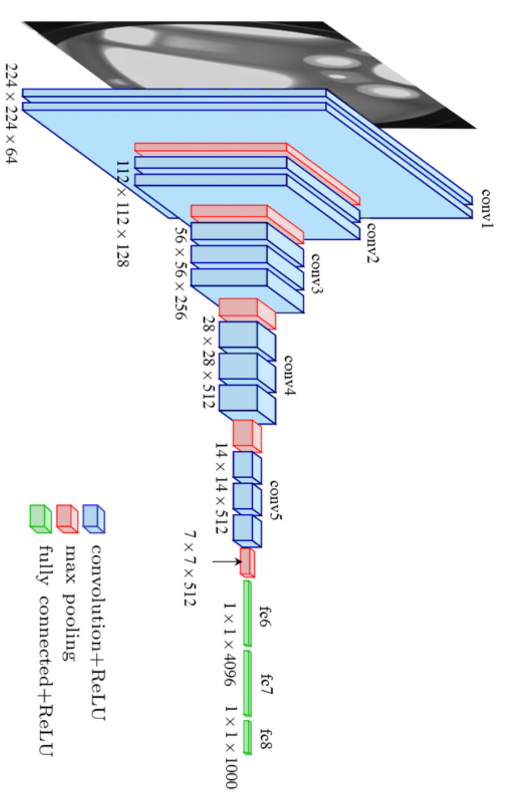
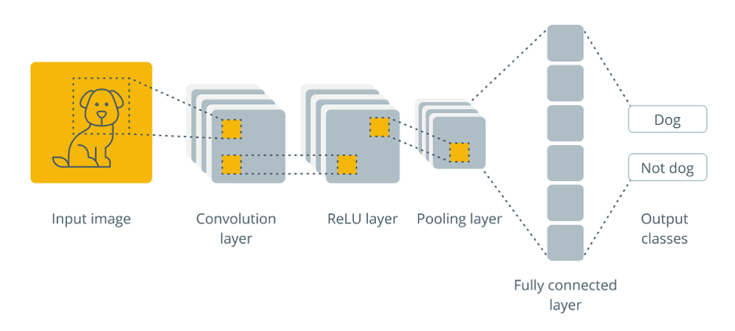
Approach Training
Visual vgg16
Use pretrainged CNN to get rough embedding of image
ADDIMG
Use contrastive learning to refine aesthetic fo the embedding
ADDIMG
Contrastive learning
retrain last 3 layers and add 2 full connected layers

Slide 15
Contrastive Learning
Approach: bring same brand closer together
Loss function:
Paremters:
Margin:
Challenge: balance between visual similarity & aesthetics. Don’t overcontrain for brands

Slide 16
Approach Training (NOT SURE HOW, MUST ADD VIZ gem Aygul)
Epcohs:
batchsize
Image
Visual vgg16
HyperParameters
Embedding 30dimensional
Contrastive learning
HyperParameters
Embedding 30dimensional

Slide 17
Training results (WandB)
Validation loss
Visualistion of embeddings of validation set

Slide 18
Cost of training (ASK: what redquired)
Show WandB
A lot of trial & error with training, high first initial cost
Reiterate not nessesary to retrain to recommend a new watch, but must be in db

Slide 19
Approach of recommendation
Have embedding,
Use KNN
6 neibrous
Manual requrements:
don’t recommend the same wathc (distance 0)
& don’t recommend more than 2 watches of the same brand
Embedding 30dimensional
Some projector of wandb, note that 30dmentionl hence not direct
2-6 watches

Slide 20
User story – end
Live demo

Slide 21
Validation. ASK ONE TIME OR CONTINUOUS
Image before & after training. See if got better
Show results (x many people asked, on avg x of 6 results resonate with user
Challenge: strike balance between

Slide 22
Try out ourself

Slide 23
Future features
Add filter for movement (which type)
Relative size
Add filter for features watch has (stopwatch, different timezones)
Slider importance of face value vs aestetic

Slide 24
Abstraction
Nessesary info for training: Brand & Image of watch.
Very little info.
Could abstract to other topics?

